Slide 1

Cross Traffic Management
Anaedu Ukamaka Akumili
Emirkan Sali
Shihab Ud Doula
Unanma Justice Chisom

Slide 2

MOTIVATION
Statement of the problem
Benefits of autonomous vehicles
Limitations
Contributions

Slide 3

ARCHITECTURAL BEHAVIOR

Slide 4
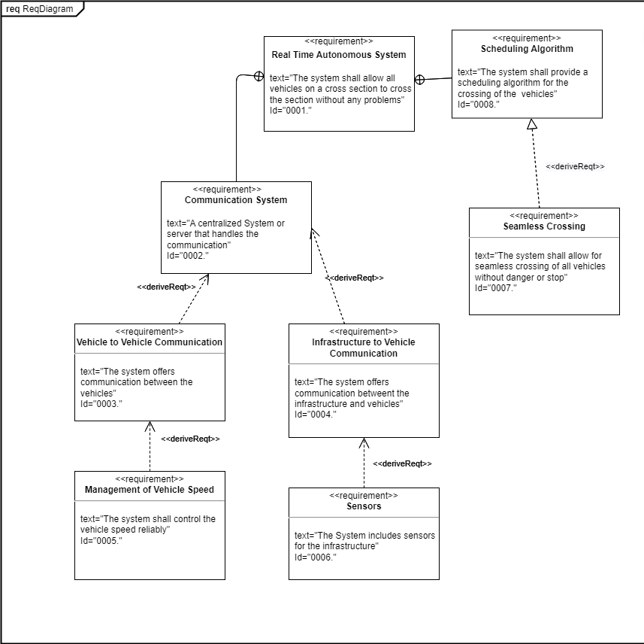
Requirements
Seamless crossing
Automated system
Communication between cars and system
Sensors
infrastructure

Slide 5
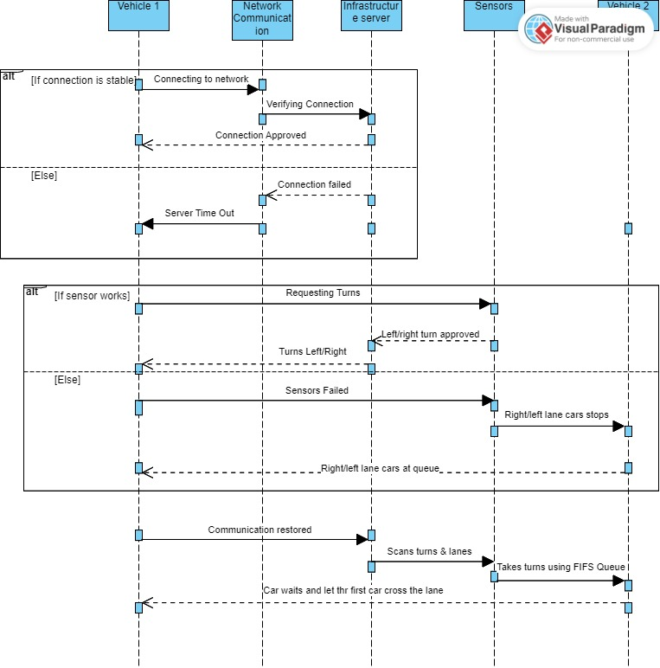
Sequence diagram

Slide 6
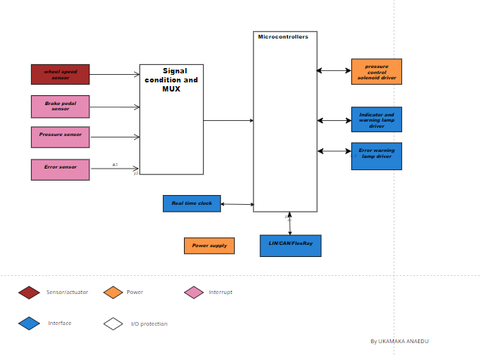
BLOCK DIAGRAM

Slide 7
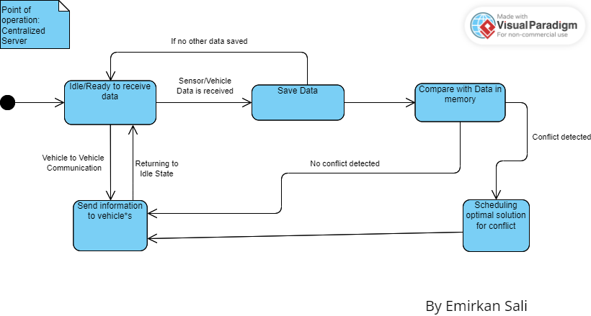
State diagram
Concept state diagram
Main states are ready state and scheduling state
Compares with internal map

Slide 8
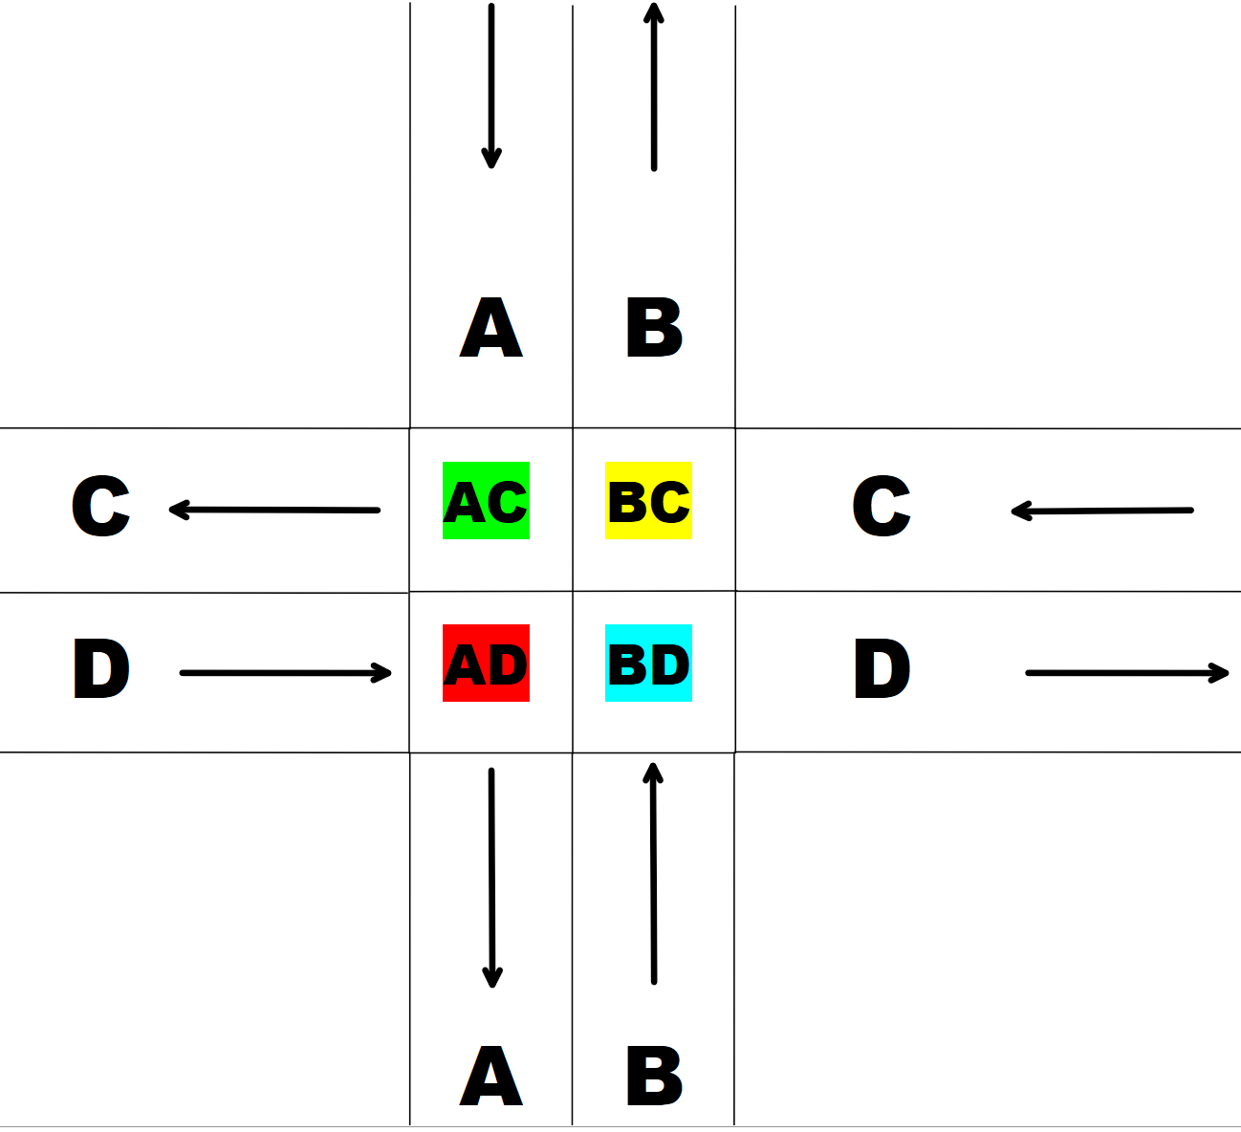
Cross- section concept

Slide 9
Uppaal Model
Separate model for a car and system
Random allocation of location and action for each car
Location, action and state of the cross section saved in arrays
FCFS queue for handling the cars

Slide 10
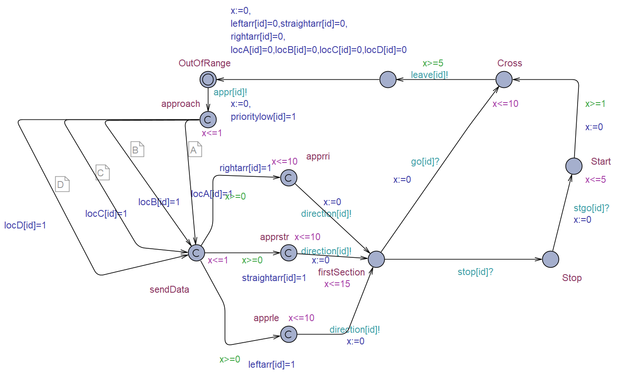
Car Uppal Model

Slide 11
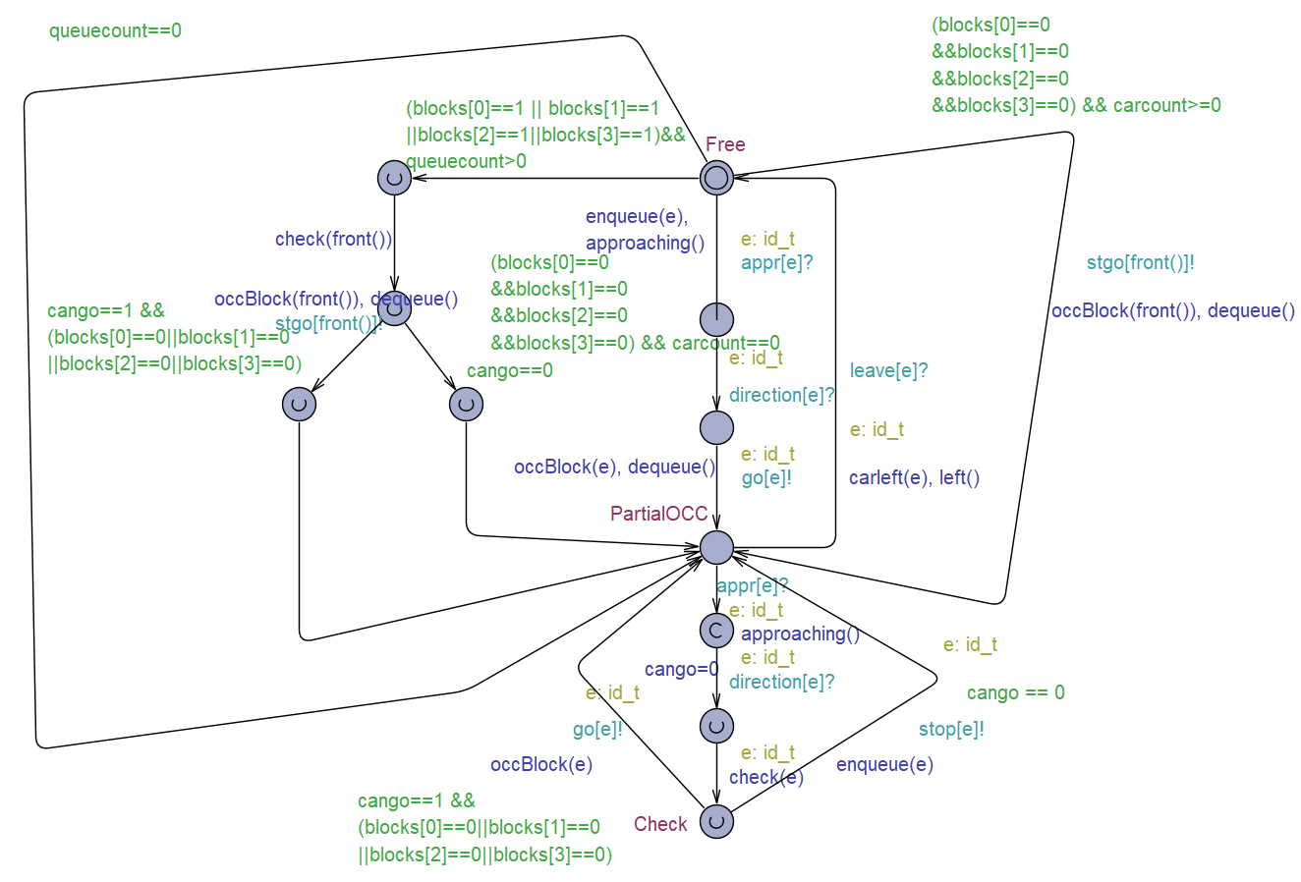
System Model

Slide 12
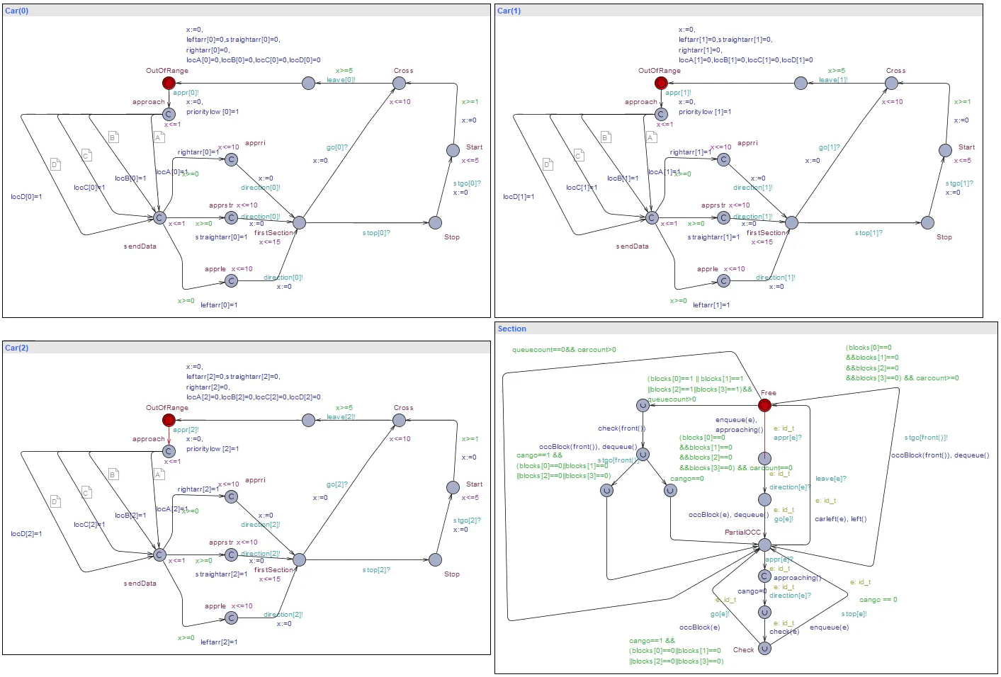

Slide 13
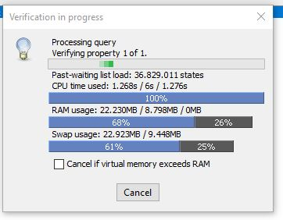
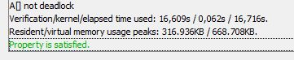
Verification

Slide 14
C++ implementation
Implementation in c++ using class for car entity
Class asigns priority, location and action randomly
Loop simulates behaviour of a cross section
Cars can spawn and approach based on random events
Car timing is updated in variable
Car checking occurs to ensure safe crossing

Slide 15
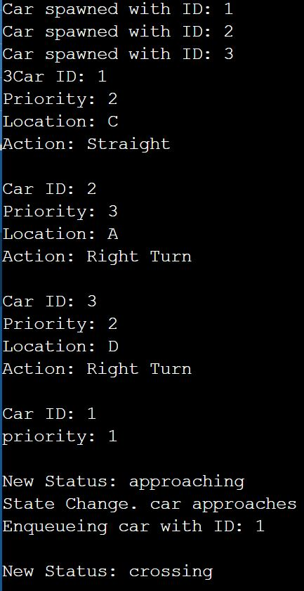
Code output

Slide 16
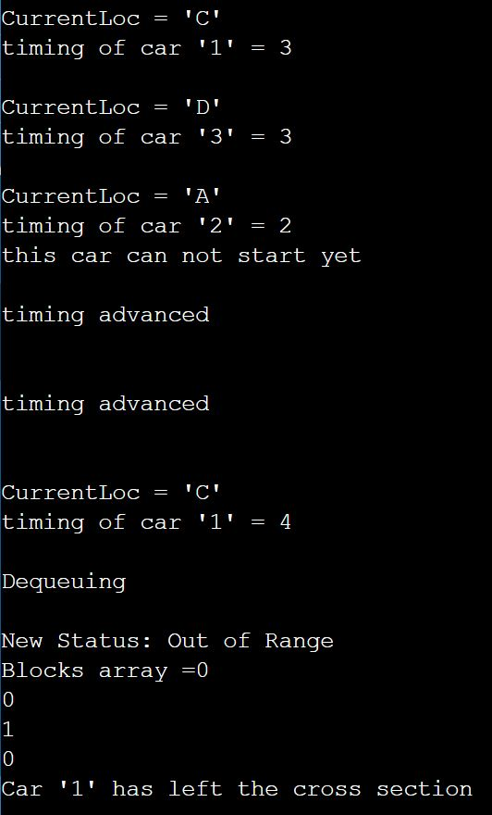

Slide 17
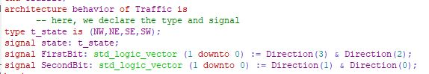
Hardware Implementation(VHDL)
Why VHDL
Entity Declaration

Slide 18
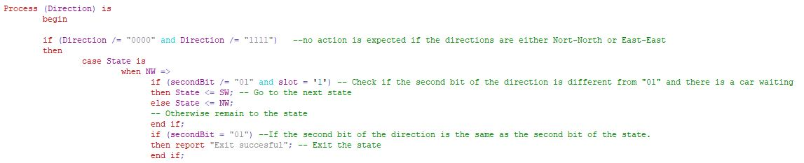
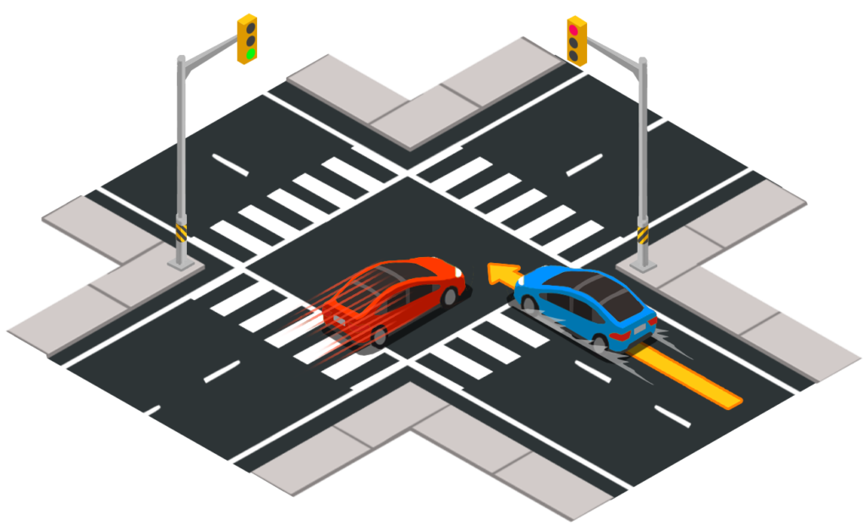
Check for direction

Slide 19

FreeRTOS
Why ?
Open source
Task Management
Real time Responsiveness
Resource Management
What it includes?
Semaphores
Mutexes
Queues

Slide 20
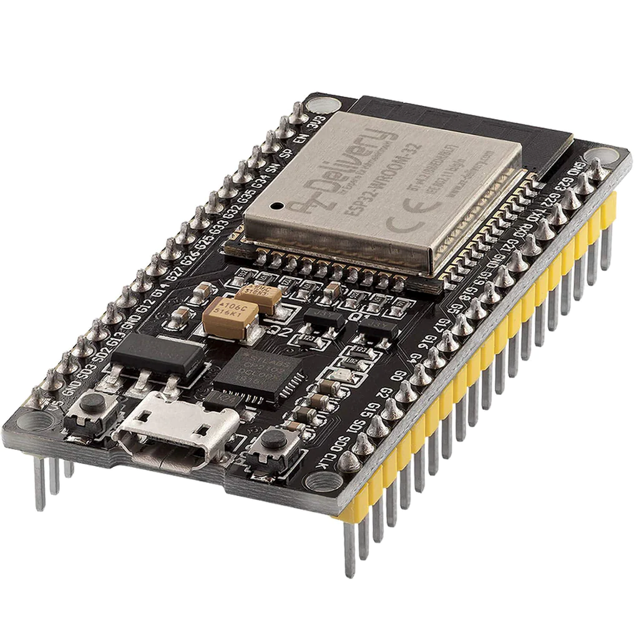
Implementations
FreeRTOS API
xTaskCreatePinnedToCore
xSemaphoreCreateMutex
xSemaphoreTake & xSemaphoreGive
vTaskDelay
Arduino ESP -32

Slide 21
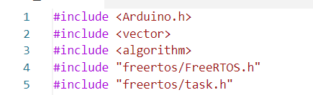
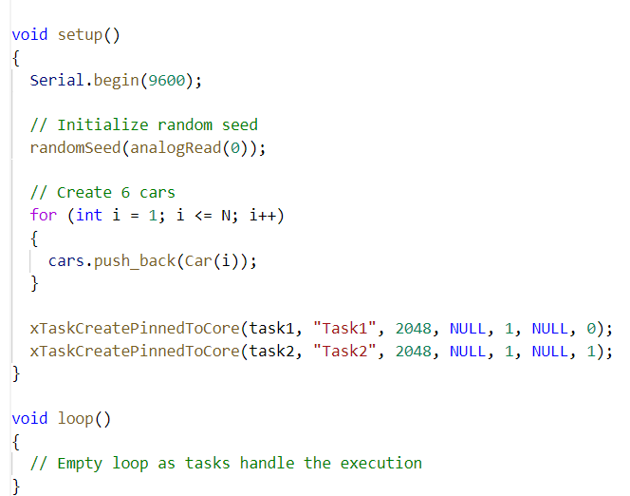
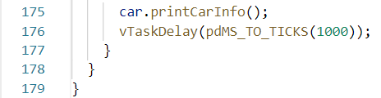
Implementation
1
2
3

Slide 22
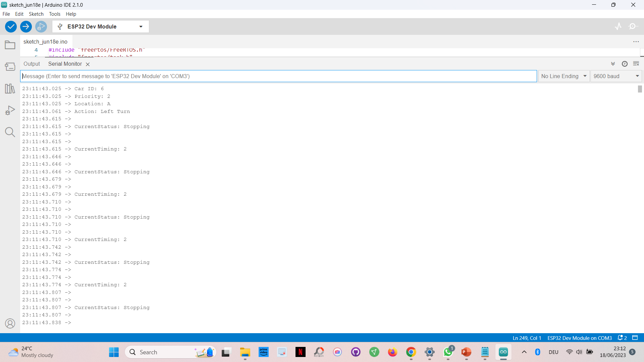
Output in Serial Monitor

Slide 23
Conclusion
Successful implementation
Integration of multiple technologies
Identified limitations
Potential of the designed system

